Slide 1






Developing statistical downscaling to improve water quality understanding and management in the Ramganga sub-basin
Surajit Ray, Marian Scott, Claire Miller, Craig Wilkie
School of Mathematics and Statistics, University of Glasgow
ICMS, October 19, 2020

Slide 2
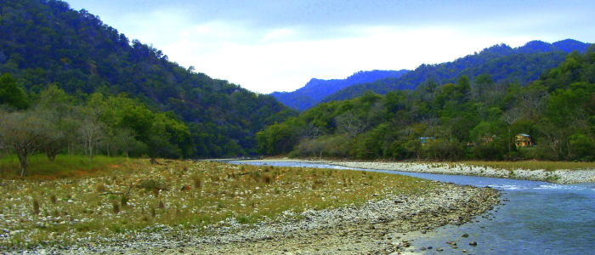




Background
The Ramganga is a major river in northern India, forming a main tributary of the Ganga
It is a vital source of water, but is polluted by agricultural fertiliser runoff, heavy metals and other chemicals from industrial cities, with sewage inflow from large populations along the river length
The Ramganga Water Data Fusion project will develop statistical methodology to fuse data from multiple sources to understand spatial and temporal water quality patterns.
Funded by EPRSC GCRF (EP/T003669/1), targeting ODA compliance
Partner Institutions
Supporting Partners
2

Slide 3
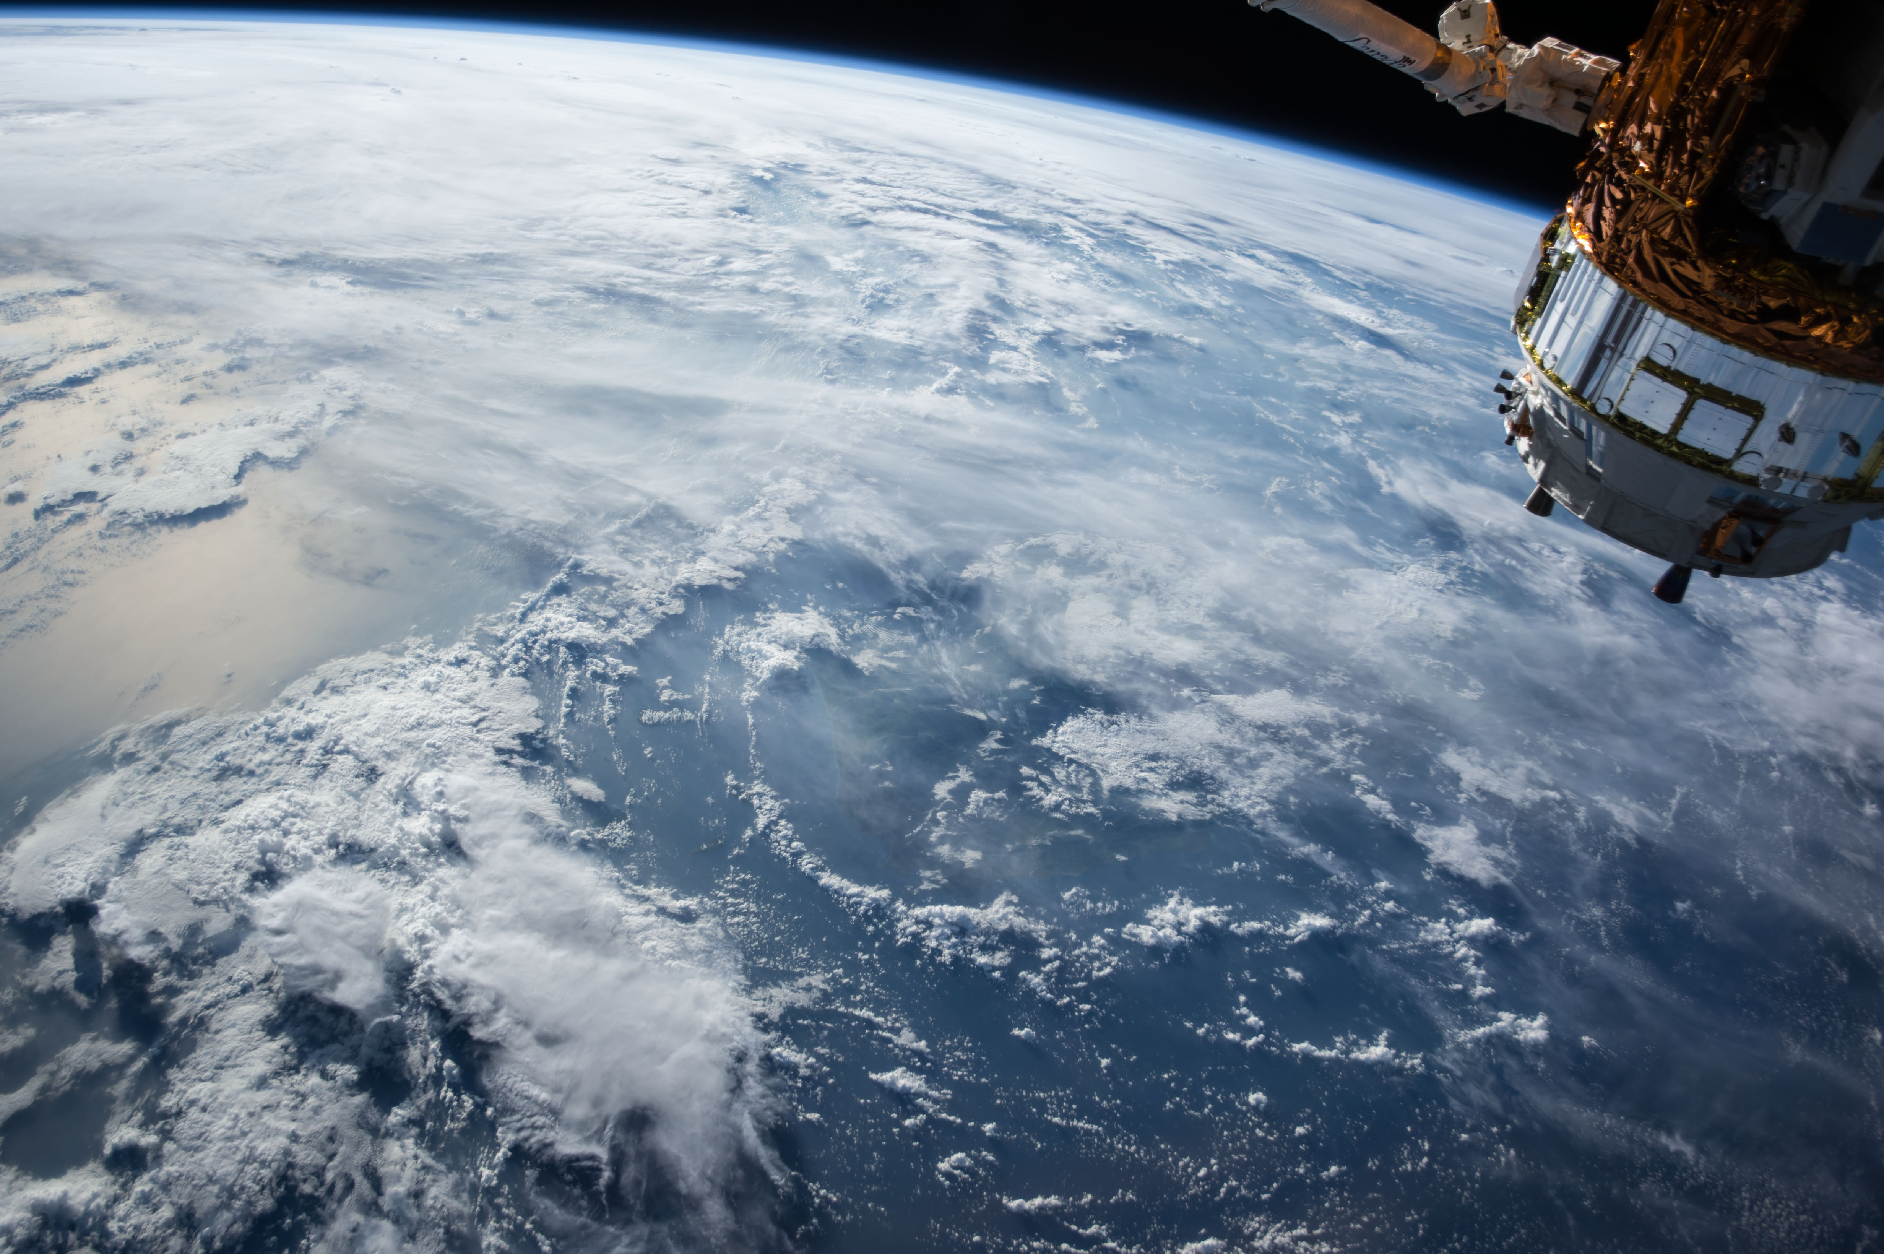
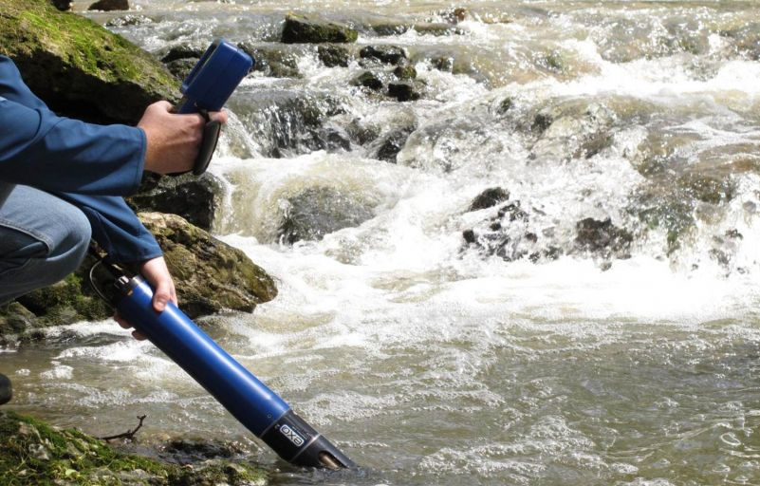
Aim
Fusion of spatially and temporally sparse in situ water quality measurements with satellite observations from Sentinel-2 and drone-mounted hyperspectral imagery
Aim to produce a spatially contiguous estimate of water quality along the river, with uncertainty quantification
Specifically, development of statistical methodology to accomplish this
3
Notes:
Fusion of spatially and temporally sparse in situ monitoring, sonde and handheld hyperspectral WISP measurements of water quality with corresponding satellite observations extracted from Sentinel-2 and drone-mounted hyperspectral imagery, providing a spatially contiguous estimate of water quality along the length of the river (with uncertainty quantification)

Slide 4
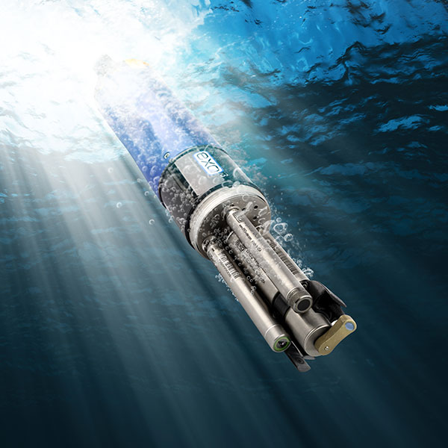
In situ from Water-Quality Sonde
4

Slide 5

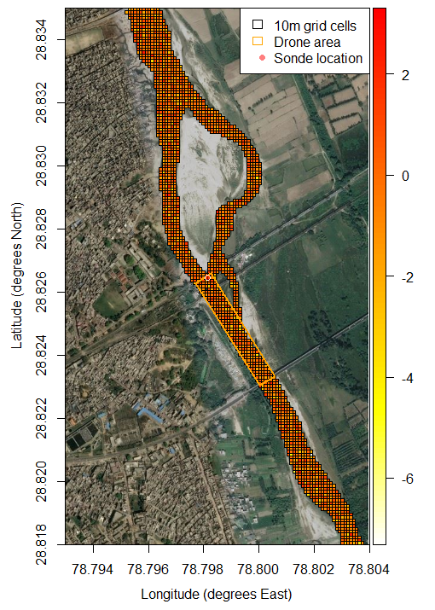
Initial focus on fusing in situ and satellite data
10m grid cells from Sentinel-2 (ESA)
Number of cells across river width varies (e.g. 3-18 in image)
In situ data locations are very sparse in space
Drone will cover short stretches of river in more detail than 10m scale (up to 1 or 2 cm) – additional methodological development required to fuse this dataset with in situ and satellite data
4

Slide 6
Existing data fusion methods
Method | Advantages | Disadvantages
Bayesian melding ^{(Fuentes and Raftery, 2005)} | Fully Bayesian | Very computationally intensive Spatial only
Fixed Rank Kriging & Spatial Statistical Data Fusion (Cressie and Johannesson, 2008; Nguyen, Cressie and Braverman, 2012) | Computationally efficient | Spatial only
INLA framework ^{(Thomas et al., 2019)} | Computationally efficient | Uses approximations Assumes discrete time
Dimension-reduced statistical downscaling (Brynjarsdóttir and Berliner, 2014; Yarali and Rivaz, 2020) | Computationally efficient Can represent large spatial regions | Assumes discrete time
Roving sensor data fusion ^{(Ludwig et al.,2017)} | Continuous space and time Allows moving sensor locations | Likely to be computationally intensive over large spatial regions
Spatially-varying coefficients regression (Gelfand et al., 2004; Sahu et al., 2010; Berrocal et al., 2010a, 2010b, 2012, 2014; Wilkie et al., 2019) | Fully Bayesian Continuous space and time | Can be computationally intensive (for predictions)
5

Slide 7
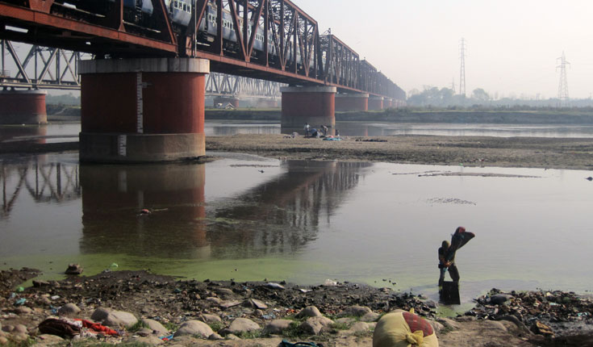
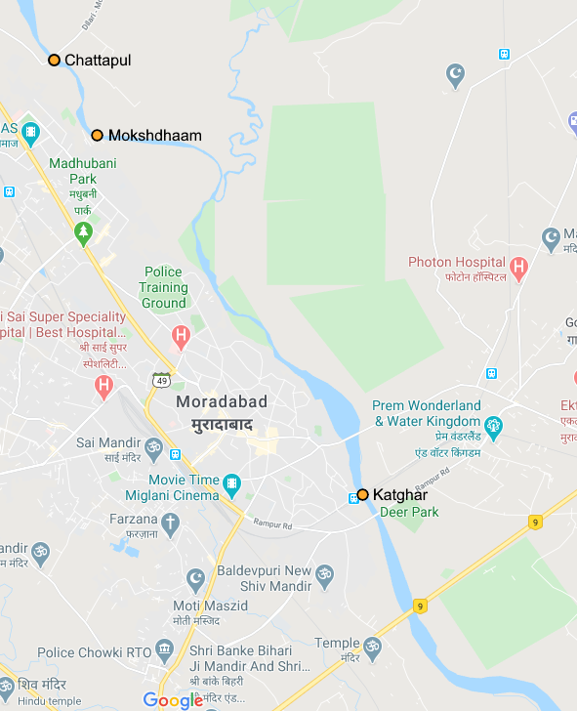


Data simulation
Data acquisition faces delays due to national and local lockdowns, so that data simulation is required
Initially, simulation of in situ and remote-sensing data.
Focus on simulating data for river around Moradabad (approximately 10km stretch), where data should be collected
8

Slide 8
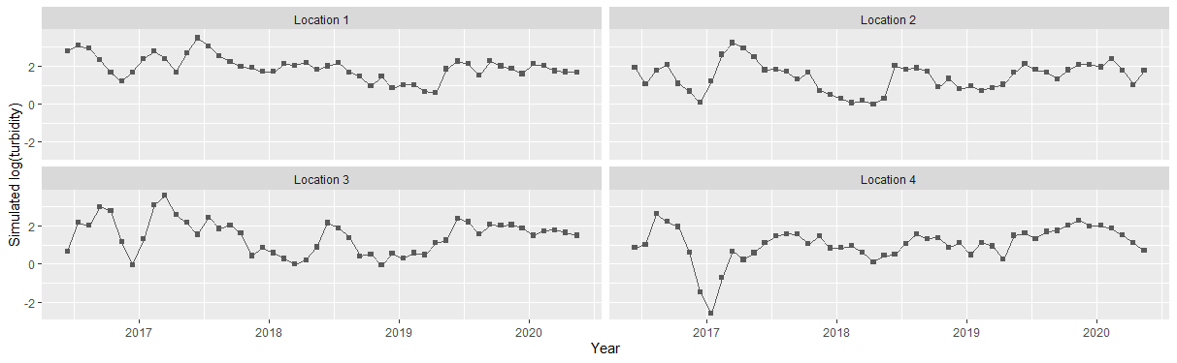
Data simulation
What is necessary for methodological development, e.g. simulation of:
point-scale in situ data
grid cell satellite data
drone data
Extra challenges for application to river data, e.g.
Appropriate mean values
Spatial patterns along river length and across river width
Seasonal patterns
9

Slide 9
Nonparametric statistical downscaling results
Predictions follow the temporal patterns in the in situ data, but intervals are very wide
High uncertainty is likely to be due to the very small number of in situ data locations
Plots of predictions over space show that the method is pulling the predictions close to the in situ data, while retaining the patterns of the satellite data
15

Slide 10
Considerations for river data
Long and thin (land contamination of remote sensing data cells on river edge)
Shifting river width and location over time: How to define river mask?
Flow direction rather than direct Euclidean distance (e.g. Ver Hoef et al., 2006)
Large number of remote sensing data points – computational difficulties
16

Slide 11

Extension to fusion of three datasets
Satellite data grid
There are three datasets available:
Point scale, point time in situ data
10m grid, monthly satellite data
1-2cm grid, point time drone data
Drone data provide good spatial resolution coverage of short river stretches, with high accuracy (no atmospheric effects and less effect of cloud cover than on satellite data)
Extra methodological development is required for spatiotemporal fusion of three datasets of different spatiotemporal support
In situ data locations
Drone data grid
17

Slide 12
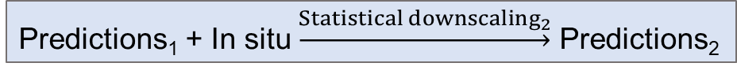
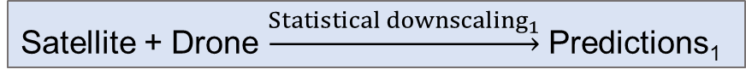
Extension to fusion of three datasets
The previous method fuses two datasets (in situ and satellite data), but drone data are also available on dense grids along the river
Method 1: fuse satellite and drone data to form a prediction surface, then fuse this with the in situ data
Method 2: fuse satellite, drone and in situ data together in a fully integrated model
Step 1
Step 2
Satellite + Drone $\underset{→}{{Statistical downscaling}_{1}}$ Predictions₁
Predictions₁ + In situ $\underset{→}{{Statistical downscaling}_{2}}$ Predictions₂
Satellite + Drone + In situ $\underset{→}{Fully integrated statistical downscaling}$ Predictions
18

Slide 13


Extension to fusion of three datasets
Method 1: fuse satellite and drone data to form a prediction surface, then fuse this with the in situ data
Simply apply the nonparametric statistical downscaling model twice (once in step 1 and once in step 2)
Can retain the uncertainties throughout, by keeping within same Bayesian hierarchical modelling framework
Potential pitfalls are how to identify the most appropriate response in Step 1 (which is most reliable of the satellite and drone data?) and how wide are the ranges of the uncertainties after two modelling steps (depends on the data)?
Step 1
Step 2
Satellite + Drone $\underset{→}{{Statistical downscaling}_{1}}$ Predictions₁
Predictions₁ + In situ $\underset{→}{{Statistical downscaling}_{2}}$ Predictions₂
19

Slide 14
Extension to fusion of three datasets
Method 2: fuse satellite, drone and in situ data together in a fully integrated model
More methodological development required, with two explanatory variables (satellite and drone data) and one response (in situ data)
How to treat the satellite and drone data? Weighting by reliability, or accommodate within hierarchical structure?
Satellite + Drone + In situ $\underset{→}{Fully integrated statistical downscaling}$ Predictions
20

Slide 15
Conclusions
River water quality data are expensive to obtain in situ, but satellite data are available at high spatial and temporal resolution
Fusing disparate datasets can help to improve the understanding of river water quality
Nonparametric statistical downscaling is a method that can fuse data to allow prediction at any time and spatial location, but the method will need to be adapted to account for stream flow distance and river properties
There are difficulties in fusing small data for very small numbers of locations
Future work will include adapting the method to allow for fusing additional data sources, such as high spatial resolution drone data
21

Slide 16
References
Berrocal, V. J., Gelfand, A. E. & Holland, D. M. (2010a). A spatio-temporal downscaler for output from numerical models. Journal of Agricultural, Biological, and Environmental Statistics, 15 (2), 176-197.
Berrocal, V. J., Gelfand, A. E. & Holland, D. M. (2010b). A bivariate space-time downscaler under space and time misalignment. The Annals of Applied Statistics, 4 (4), 1942-1975.
Berrocal, V. J., Gelfand, A. E. & Holland, D. M. (2012). Space-time data fusion under error in computer model output: An application to modelling air quality. Biometrics, 68 (3), 837-848.
Berrocal, V. J., Gelfand, A. E. & Holland, D. M. (2014). Assessing exceedance of ozone standards: a space-time downscaler for fourth highest ozone concentrations. Environmetrics, 25 (4), 279-291.
Brynjarsdóttir, J. & Berliner, L. M. (2014). Dimension-reduced modeling of spatio-temporal processes. Journal of the American Statistical Association, 109 (508), 1647-1659.
Cressie, N. & Johannesson, G. (2008). Fixed rank kriging for very large spatial data sets. Journal of the Royal Statistical Society: Series B (Statistical Methodology), 70 (1), 209-226.
Fuentes, M. & Raftery, A. E. (2005). Model evaluation and spatial interpolation by Bayesian combination of observations with outputs from numerical models. Biometrics, 61 (1), 36-45.
Gelfand, A. E., Kim, H.-J., Sirmans, C. & Banerjee, S. (2003). Spatial modelling with spatially varying coefficient processes. Journal of the American Statistical Association, 98 (462), 387-396.
Ludwig, G., Chu, T., Zhu, J., Wang, H., Koehler, K. et al. (2017). Static and roving sensor data fusion for spatio-temporal hazard mapping with application to occupational exposure assessment. The Annals of Applied Statistics, 11 (1), 139-160.
Nguyen, H., Cressie, N. & Braverman, A. (2012). Spatial statistical data fusion for remote sensing applications. Journal of the American Statistical Association, 107 (499), 1004-1018.
Sahu, S. K., Gelfand, A. E. & Holland, D. M. (2010). Fusing point and areal level space-time data with application to wet deposition. Journal of the Royal Statistical Society: Series C (Applied Statistics), 59 (1), 77-103.
Ver Hoef, J. M., Peterson, E. & Theobald, D. (2006). Spatial statistical models that use flow and stream distance. Environmental and Ecological Statistics, 13, 449-464.
Wilkie, C. J., Miller, C. A., Scott, E. M., O'Donnell, R. A., Hunter, P. D., Spyrakos, E. & Tyler, A. N. (2019). Nonparametric statistical downscaling for the fusion of data of different spatiotemporal support. Environmetrics, 30 (3), e2549.
Yarali, E. & Rivaz, F. (2020). Incorporating covariate information in the covariance structure of misaligned spatial data. Environmetrics, e2623.
22

